Slide 1
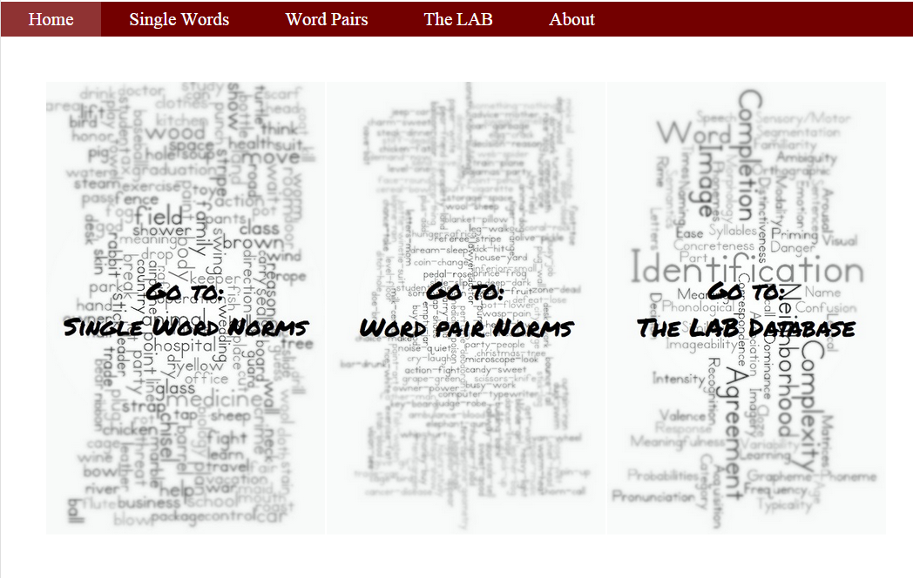
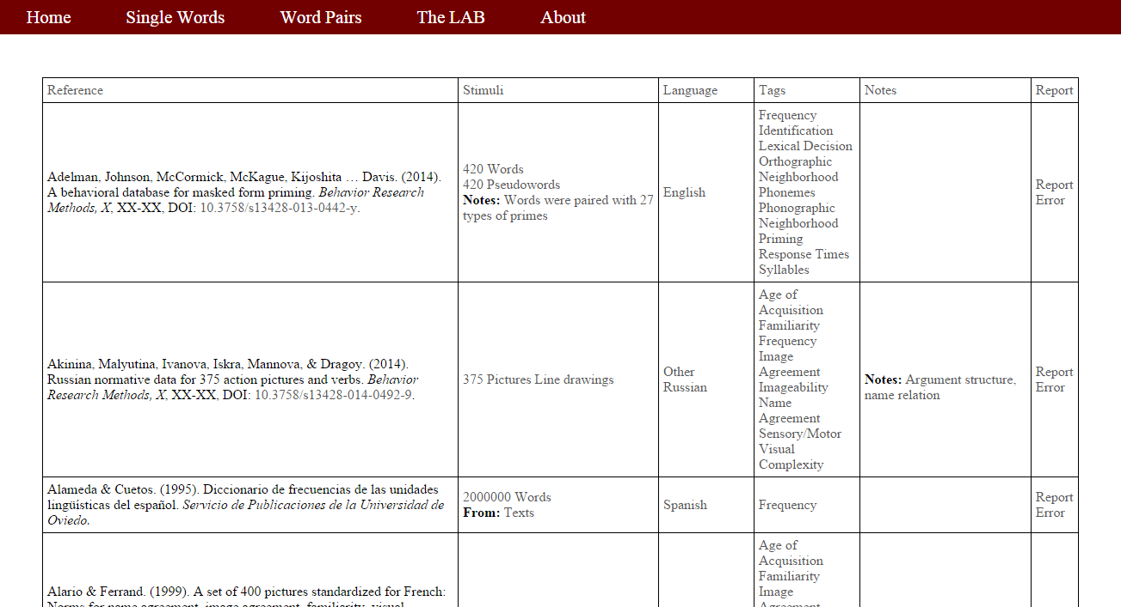
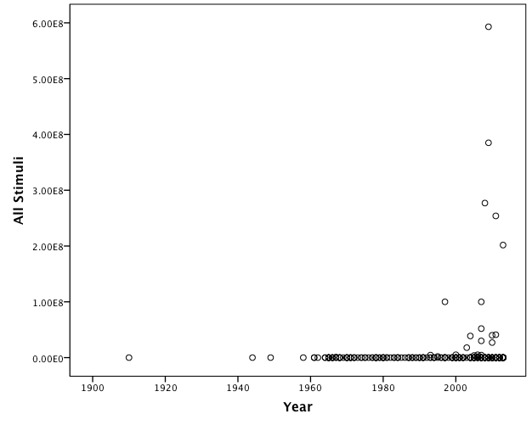
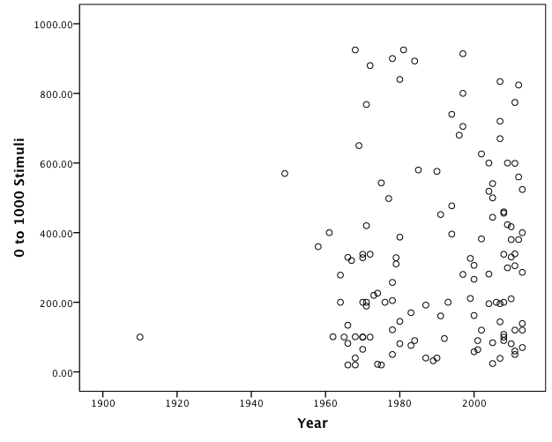
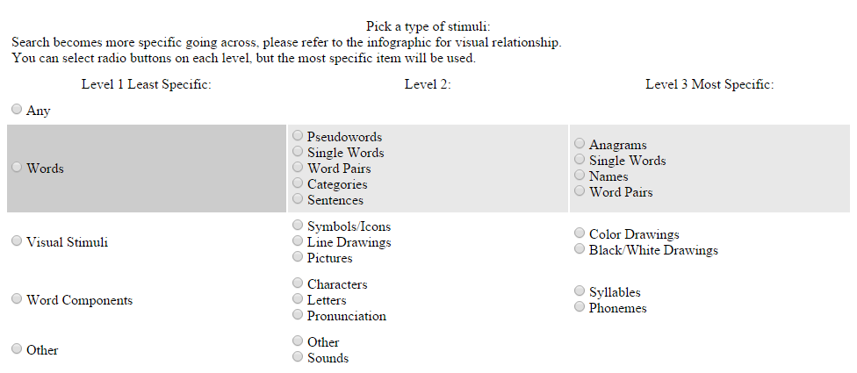
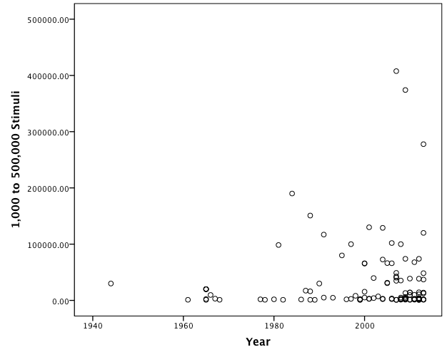
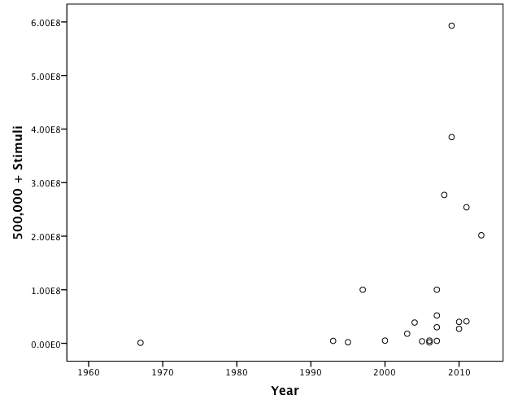
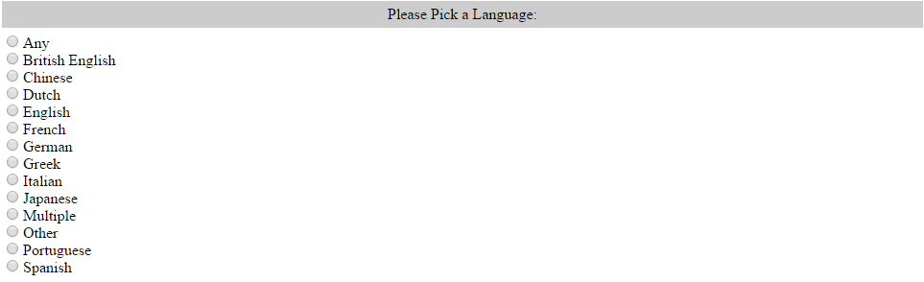
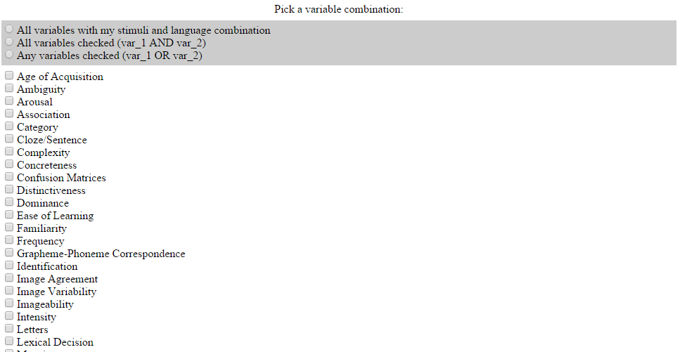
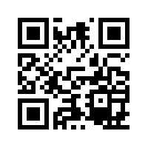
LAB: Linguistics Annotated Bibliography – A searchable Portal for Normed Database Information
Erin M. Buchanan, Kathrene D. Valentine, Marilee L. Teasley, Kayla N. Jordan, Marshall T. Beauchamp
Missouri State University
Abstract
Psycholinguistic research is flourishing with numerous publications advancing our knowledge of word characteristics and ways to study them. This presentation showcases the Linguistic Annotated Bibliography (LAB) as a searchable web portal to quickly and easily access reliable database norms, related programs, and variable calculations. Nearly 600 publications were coded by language, number of stimuli, stimuli type (i.e. words, pictures, symbols), keywords (i.e. frequency, semantics, valence), and other useful information. This tool not only allows researchers to search for the specific type of stimuli needed for experiments, but also permits the exploration of publication trends across 100 years of research. Details about the portal creation and use are outlined, as well as various analyses of change in publication rates and keywords. In general, advances in computation power have allowed for the increase in dataset size in the recent decades, in addition to an increase in the number of linguistic variables provided.
The LAB in Action
Trends
The home page allows you to select single word norms, word-pair norms, or the LAB for further exploration.
Norms from Buchanan et al. (2012).
Figure 1. Number of publications plotted in half decade intervals.
Most Popular Stimuli: Word Norms (50%)
Quantity of Stimuli: 10 to 593,000,000
Most Common Publication: Behavior Research Methods (60%)
Number of Tags/Variables: Increased over time, r = 0.26, p = 0.10
For example: age of acquisition, familiarity, imagery, orthographic
neighborhood, syllables, and valence norms
Number of non-English norms: before 2004, 18% of norms were Non- English or multiple languages, 2004-now increased to 51%.
Importance
Normed stimuli allow for controlled research experiments and are important predictors for psychological phenomena.
Normed stimuli expand our knowledge of memory and language systems.
Purpose
To present a searchable, cataloged database of normed stimuli and related materials for a wide range of experimental research, and
To examine trends in the publications of these articles to assess data movement within psycholinguistics.
The LAB Options
LAB is available at http://www.wordnorms.com and was designed as a dynamic host of psycholinguistic stimuli.
Users options include:
1) Suggest articles,
2) View all currently entered articles,
3) Search the database for specific keywords, and
4) View various statistics about the database.
Resources used for article collections: Bradshaw (1984), Proctor & Vu (1999), Academic Search Premier, PsycInfo, ERIC, Google scholar, Springer Journals.
Keywords searched: corpus, linguistic database, linguistic norms, norms, and database.
Inclusion criteria:
1) Contained database information as supplemental material,
2) Demonstrated programs related to building research stimuli
using normed databases, or
3) Generated new calculations of lexical variables.
Number of articles included in the database: ~597
Information gathered for each article:
1) Journal information,
2) Stimuli types,
3) Stimuli language,
4) Programs or corpus name,
5) Keywords/tags,
6) Special populations, and
7) Other notes that did not fit into those categories.
You can view the articles currently present in the LAB in either a small output format (easier to read) or large output format (easier to copy).
The search function allows you to search by type of stimuli, language, and keyword tags. This search function is available with both small and large output.
Stimuli search is structured in a hierarchical format to allow for varying levels of search specificity.
Other available LAB utilities include a data entry point to add to the database, a link to report data entry errors, dynamic reports for trends in stimuli, and info pages for updates to the database.
Figure 2. Scatterplots of number of stimuli by year. The top left quadrant shows all years and stimuli, the top right quadrant shows stimuli numbers in the 0 to 1000 range, and the bottom two quadrants show 1,000 – 500,000, and 500,000+ numbers of stimuli across years.
Discussion
We believe the database will be of great use for students and established researchers to discover stimuli that can be used in their experiments or for further research. By collecting this data in one place, we can cross reference stimuli and examine the current directions in psycholinguistic research. We encourage researchers to aid in identification of missing or new publications.
Contact
Corresponding author: erinbuchanan@missouristate.edu

